Slide 1
Special Theory of Relativity
M V V K Srinivas Prasad
Assistant Professor
Dept. of Physics

Slide 3
Basic Definitions
Reference Frame: It is a space in which we are making the observations and measuring the physical quantities.

Slide 4
Reference Frame
Inertial Frame of Reference
Non-Inertial Frame of Reference

Slide 5
Basic Definitions
Inertial Frame of Reference:
Newton’s First law of motion holds good.
The reference frame is either at rest or moves with constant velocity.
Non-Inertial Frame of Reference:
Newton’s First law is not valid.
The reference frame is accelerating in linear fashion or rotating around the same axis.

Slide 6
Inertial Frame of Reference
Non-Inertial Frame of Reference
Newton’s First LAW is valid.
Body is un-accelerated.
Body is at either rest or moving with constant speed.
Newton’s First LAW is not valid.
Body is accelerated.
Body is moving with increasing speed like rotating bodies.

Slide 7
Principle of Relativity:
Basic laws of Physics are same in all inertial reference frames.
As you go from one reference frame to another things like Forces, Mass, Length and Time does not change. These quantities are said to be absolute.
All Inertial frames are equivalent.

Slide 8
Einstein’s Postulates
All laws of Physics including Maxwell’s Theory of Electromagnetism holds good in all Inertial frames of reference. This is an extension of Principle of Relativity.
The speed of light in vacuum has the same value in all inertial frames of reference; independent of the speed of the observer or that of the source emitting the light.

Slide 9
Galilean Transformation

Slide 10
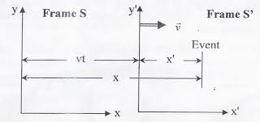
Galilean Transformation

Slide 11
Galilean Transformation

Slide 12
Galilean Transformation

Slide 13
Galilean Transformation

Slide 14
Galilean Transformation

Slide 15
Lorentz Transformation

Slide 16
Lorentz Transformation

Slide 17
Lorentz Transformation

Slide 18
Lorentz Transformation

Slide 19
Lorentz Transformation

Slide 20
Lorentz Transformation

Slide 21
Lorentz Transformation

Slide 22
Lorentz Transformation

Slide 23
Time Dilation

Slide 24
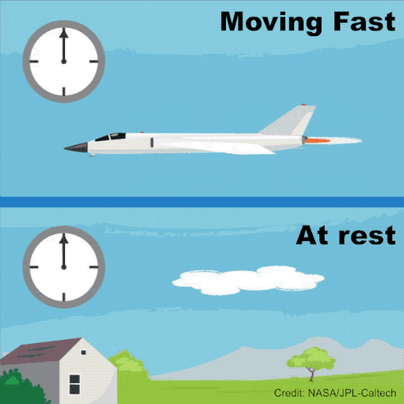
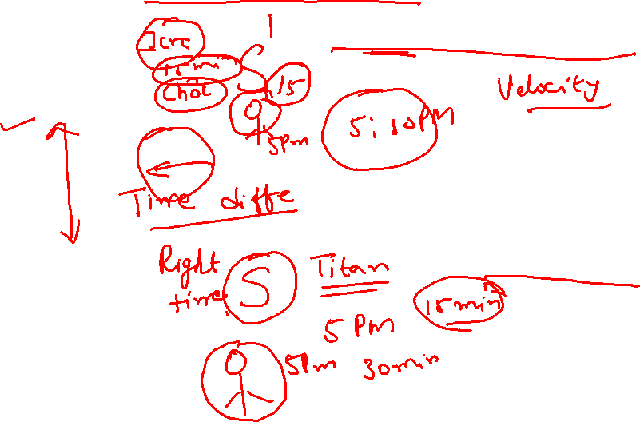
Time Dilation

Slide 25

Time Dilation
A clock in a moving frame of reference measures a longer time interval between two events while for the same event the clock in the stationery frame of reference measures a short time interval.

Slide 26
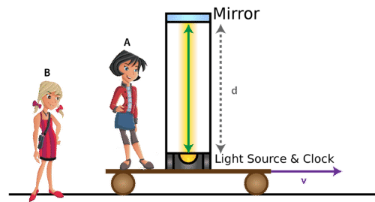
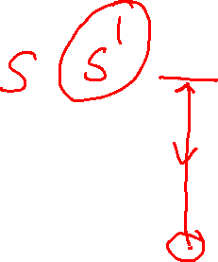

Slide 27
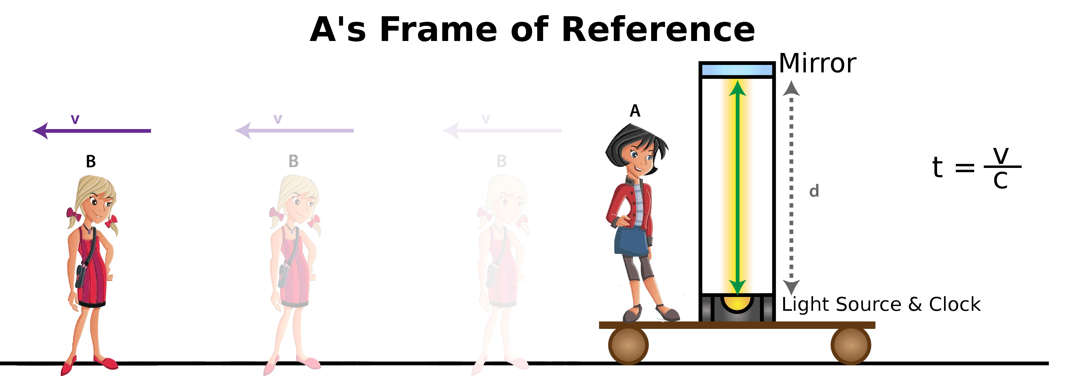
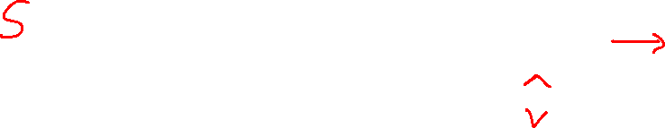

Slide 28
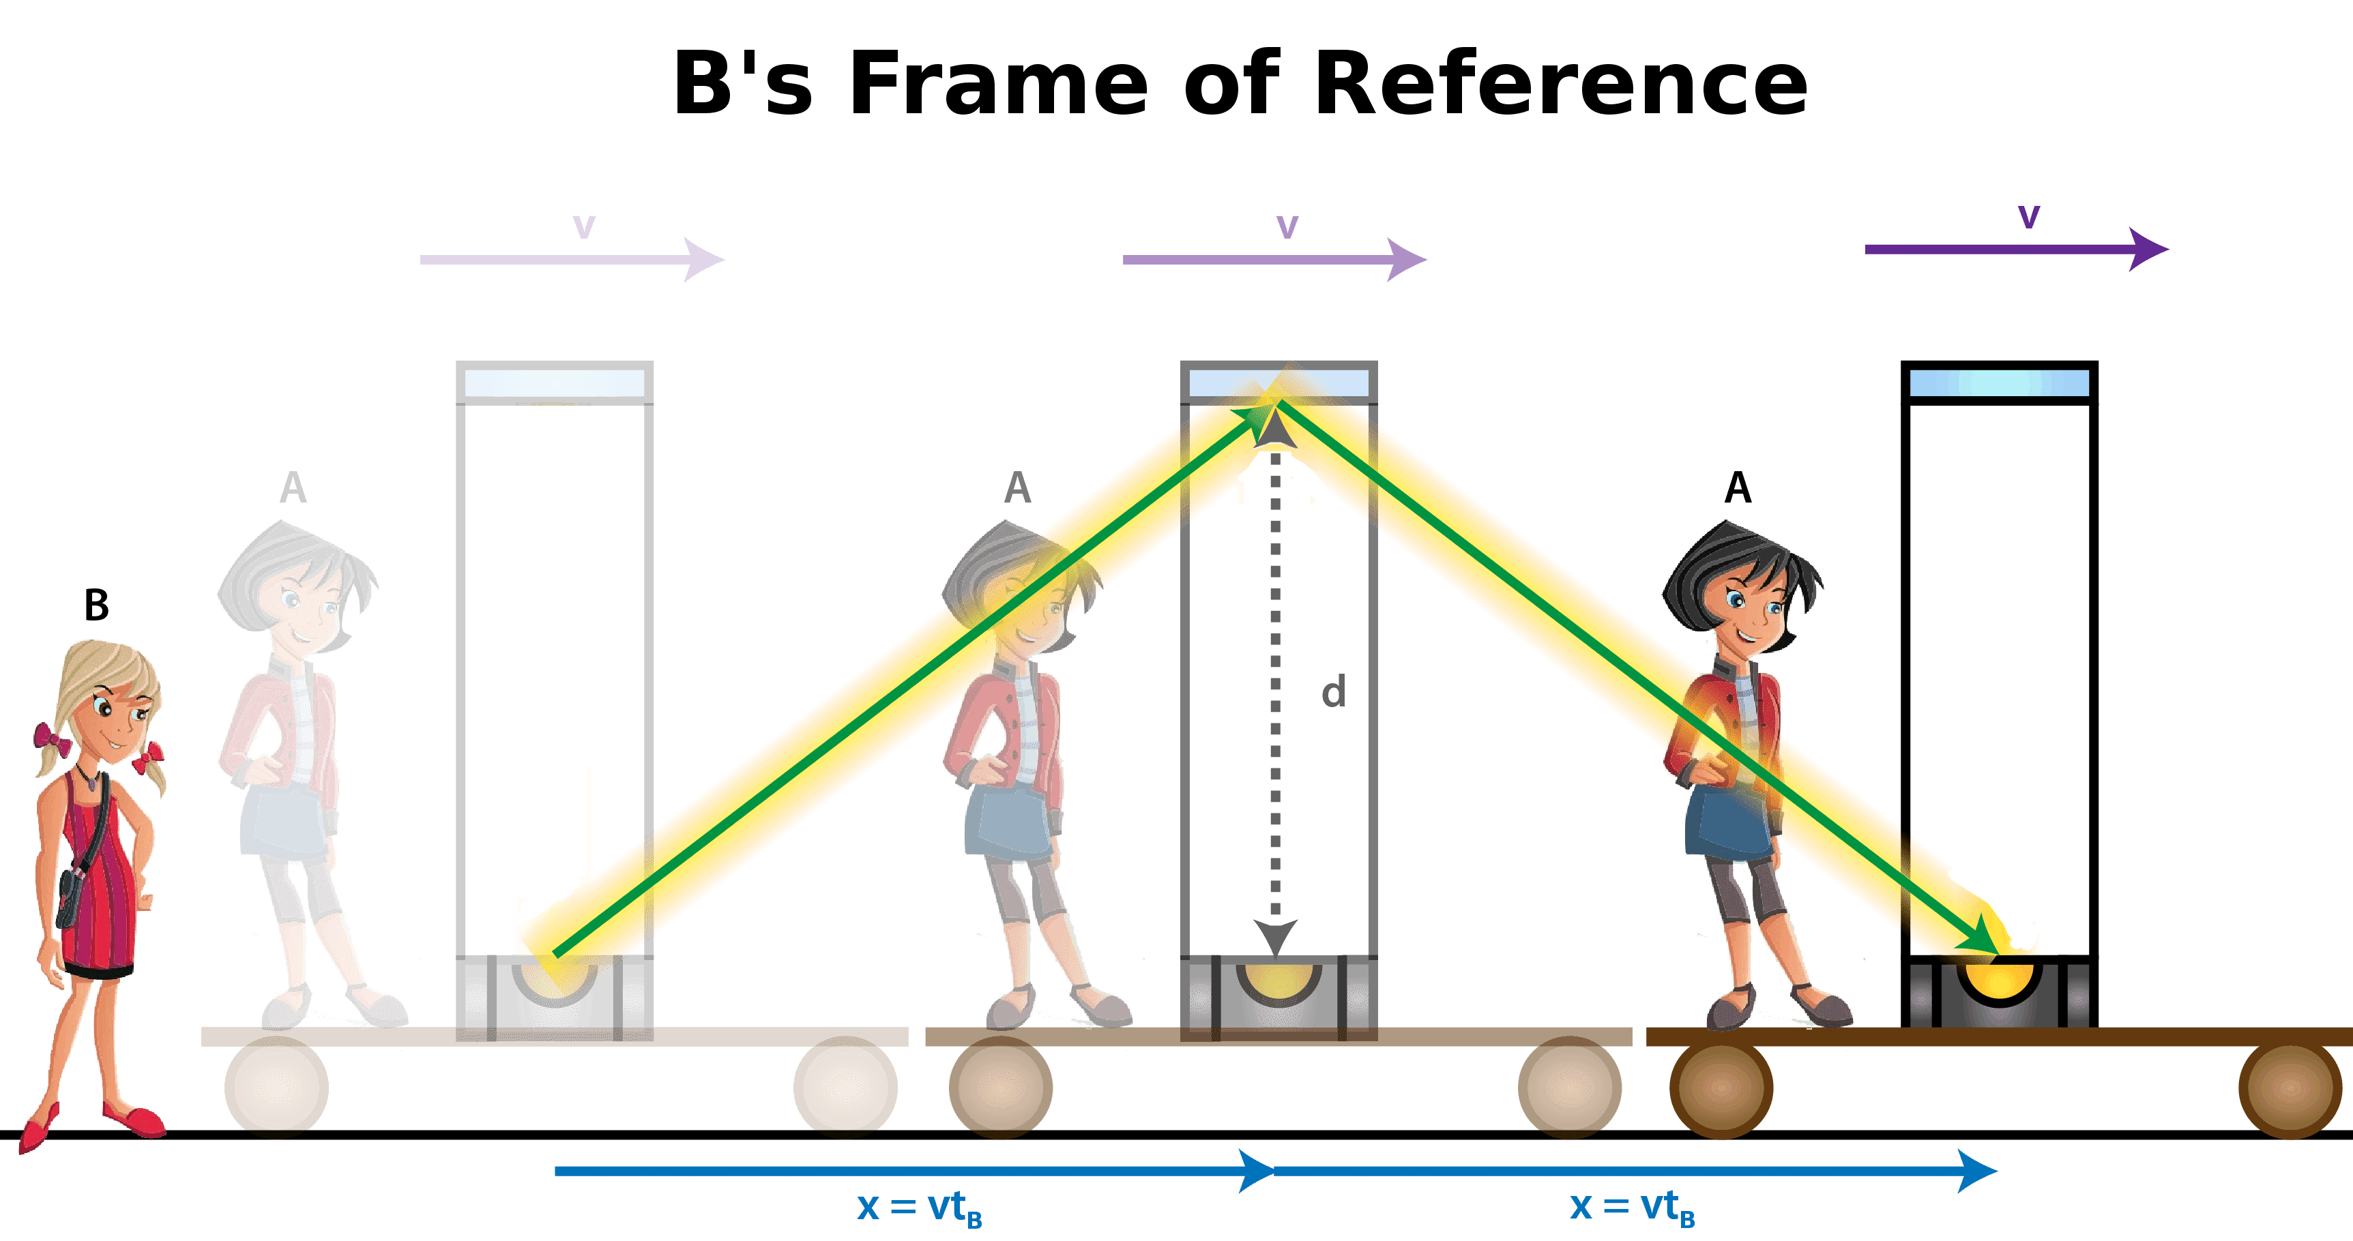
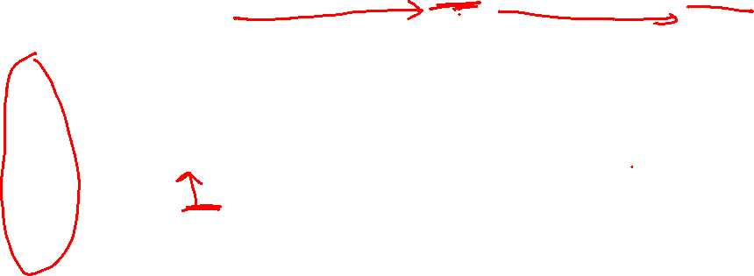

Slide 29
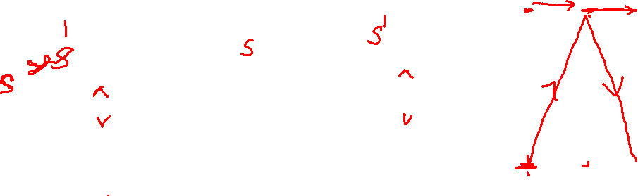

Slide 30
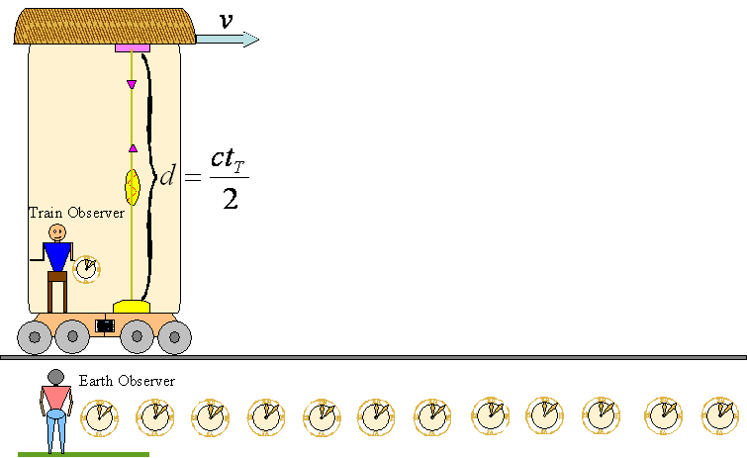
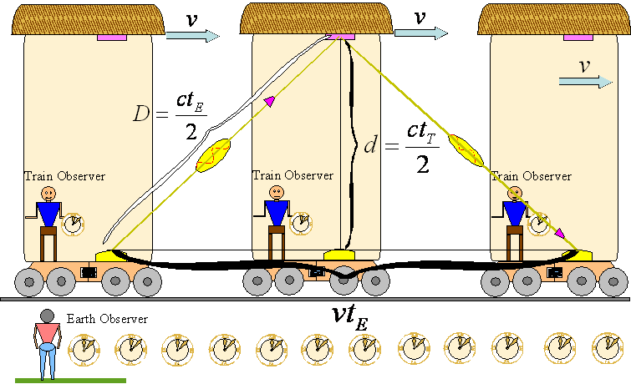


Slide 31
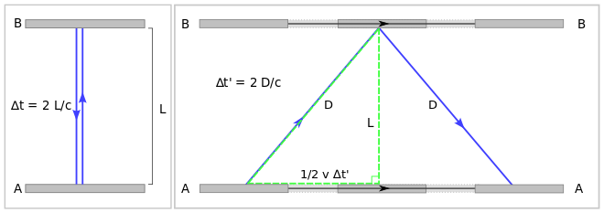
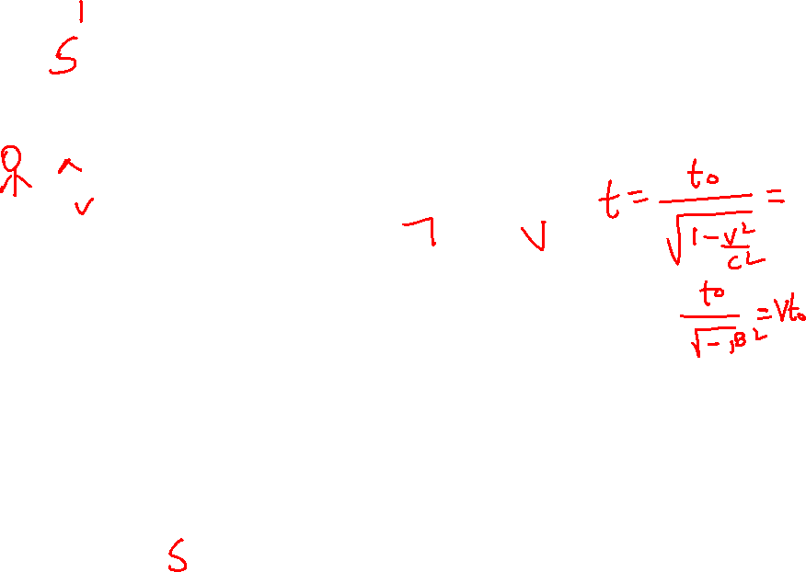

Slide 32
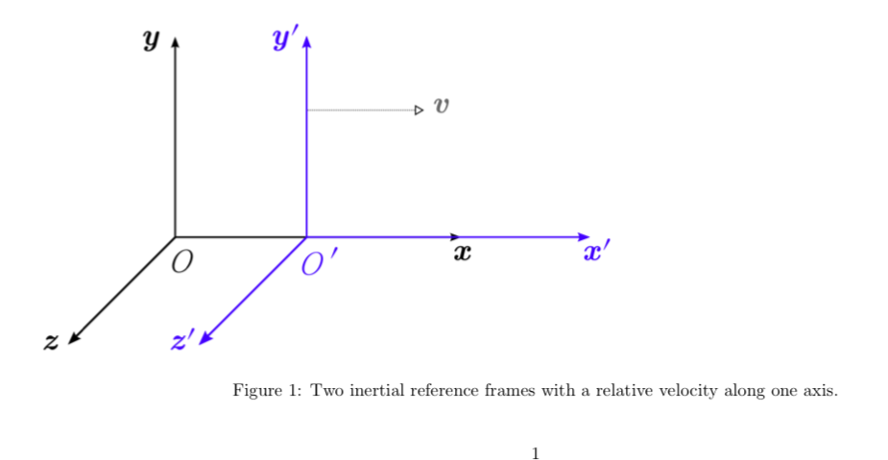
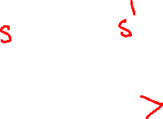

Slide 33
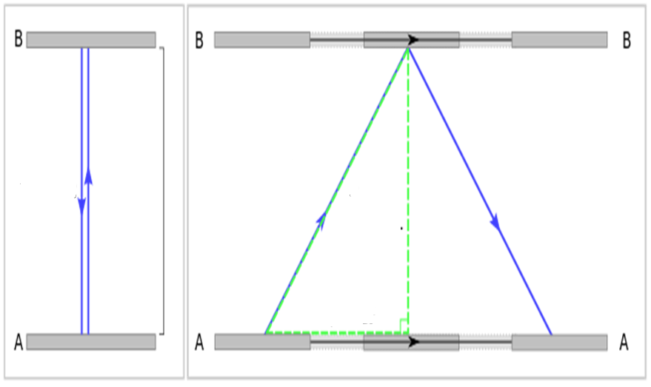
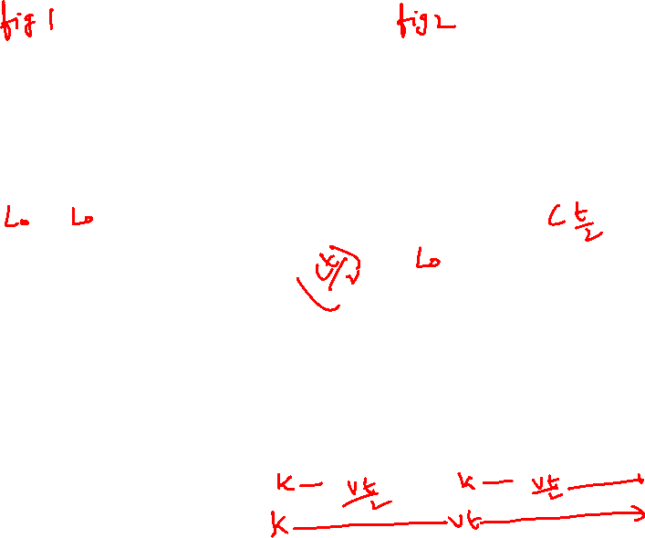


Slide 34
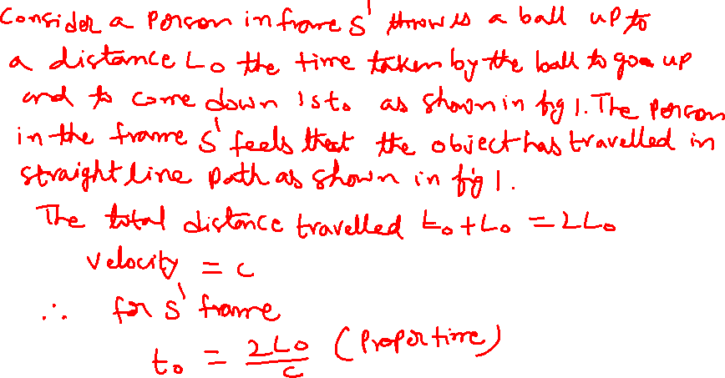

Slide 35
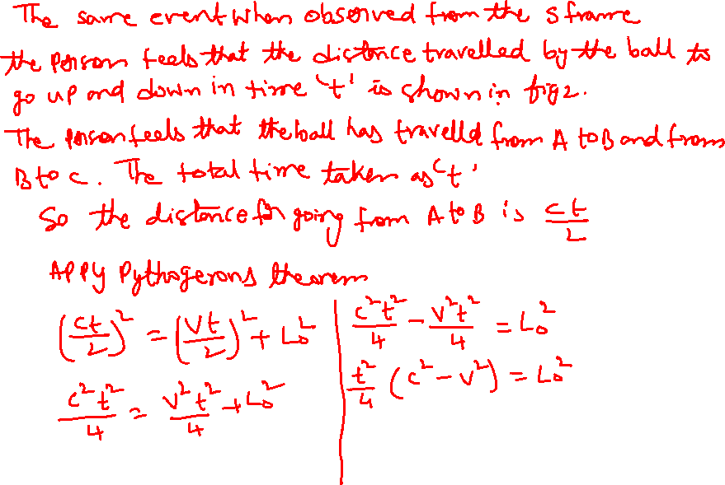

Slide 36
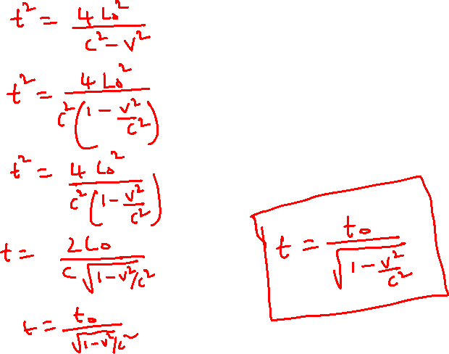

Slide 37
Length Contraction

Slide 38
Proper Length: The length of any object measured by an observer at rest with respect to object is called proper length.
Length Contraction: The length of any object moving with high velocity (approachable to velocity of light) relative to an observer is measured contracted in the direction of motion. While no change in other direction perpendicular to the motion. This phenomenon is called length contraction.

Slide 39
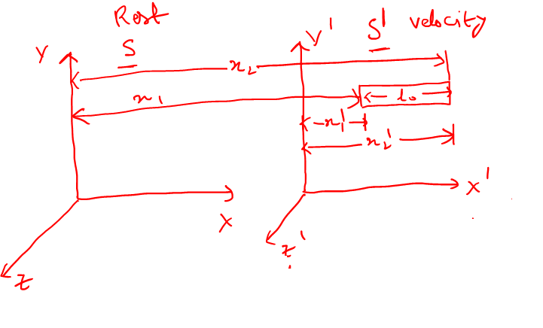

Slide 40
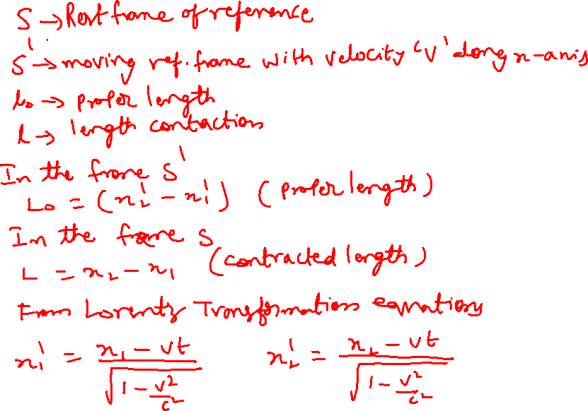

Slide 41
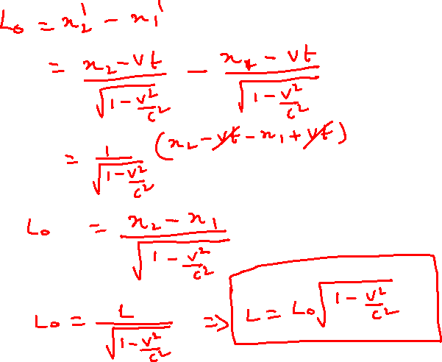

Slide 42
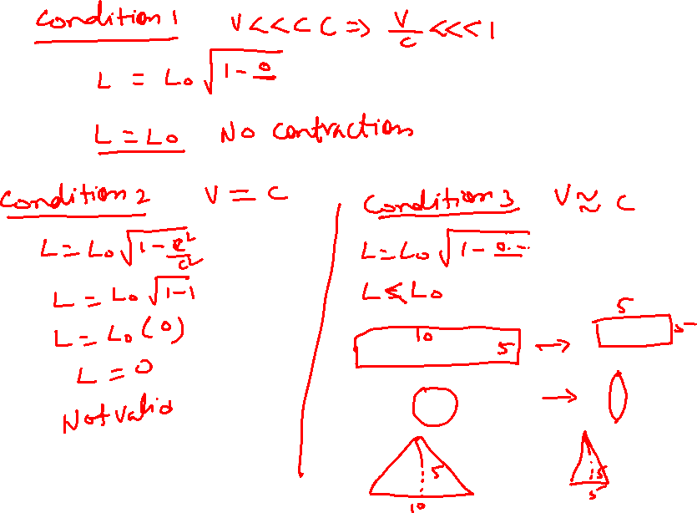

Slide 43
Variation of mass with velocity

Slide 44
Variation of mass with velocity

Slide 45
Variation of mass with velocity

Slide 46
Variation of mass with velocity

Slide 47
Variation of mass with velocity

